Slide 1
Secondary Rhinoplasty Why????
Prof. Dr. Samia Saied

Slide 19
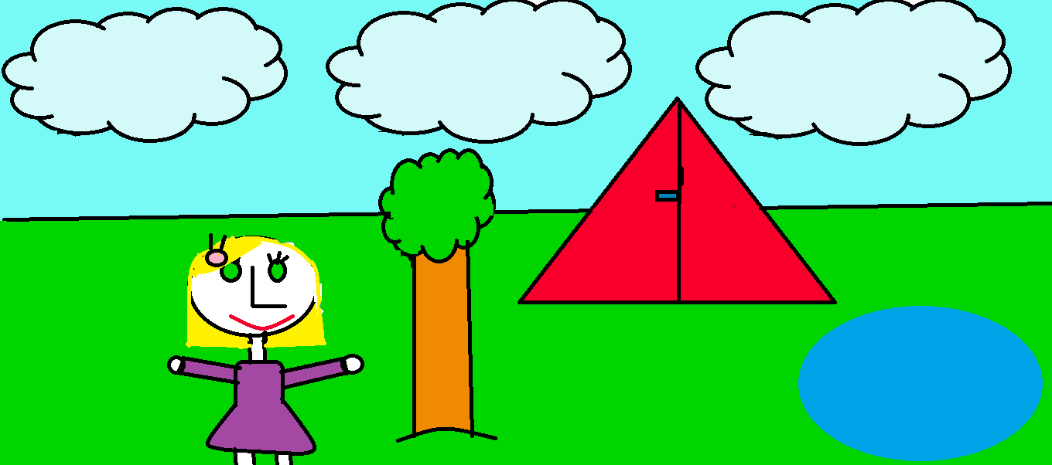
Thanks

